Slide 1
Nomoto
Least changes
Physically possible
Comfortable change
Expected route
MT
Manoeuvring
Capability
DWT, L, B, Speed, ...
COLREGs
Local
Marin
Area with initial probability
CS
Situation Awareness
Regulations
Well-clear
Safe motion parameters
t, X, Y, P
Dynamic
Probability index
Decision making
Szlapczynski
course, speed
Heatmap
Highest probability
Test with
Seafarers using tool
Advise crew using tool
VHF & AIS
Iterate map for every timestep
Other vessels summarized and seperate
Predicted capability envelope
Protocols
Routeplanner
Simulate
Possible decisions
Communication
Filter low probabilities
Hazards
Where is what ship (closest point of approach)?
In practice
Filter situation
Information available at bridge
Validate by testing tool
Talk with seafarers
Regulations &
Education
TSS
Map/radar
Shared
Static objects
No implementation
Only specific cases
Mental model
Instruments
Parameters
Usage
Master & other crew
Regulations
Implementation
In practice based on seafarers
Model of thoughtproces, with general considerations

Slide 2
Mental model
Map of situation
Predict future states
Action
Strategy
Execute
Evaluate
Extract
Evaluate
Decide
Update mental model
Mitigate risk via communication
Sensors
Paramaters
Information
Static hazards
Relevant objects
Dynamic hazards
Own manouvrability
Communicate when unsuccesfull
Safe motion parameters
Filter situation
Hazard criteria
Routeplanning criteria

Slide 3
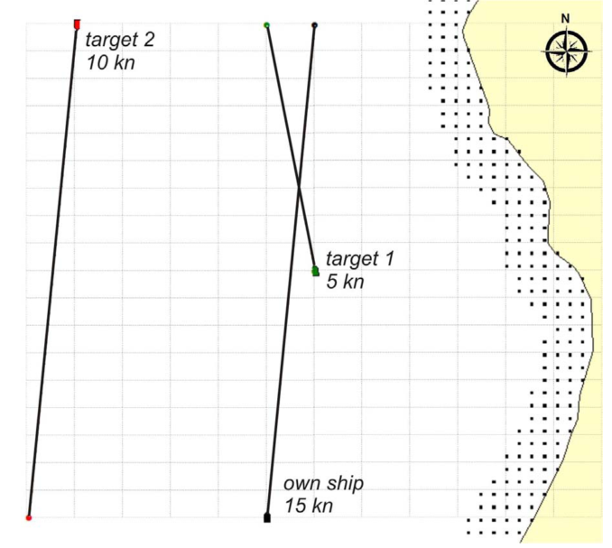

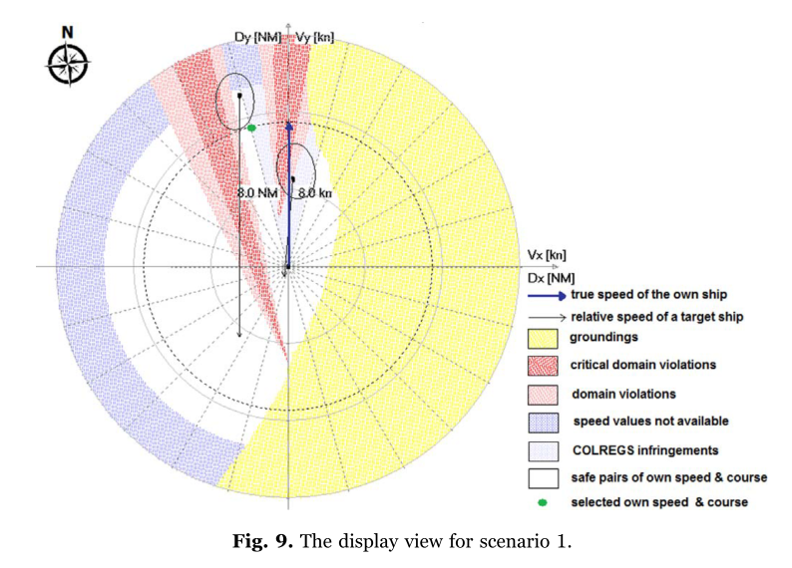
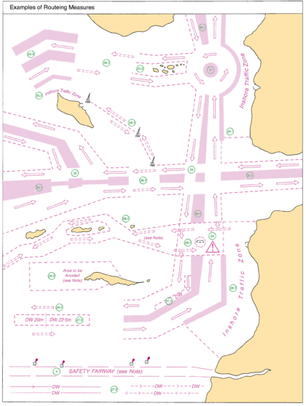
Szlapczynski
Heatmap own vessel
Safe motion parameters
Heatmap others
T = 5 sec
T = 30 sec
T = 60 sec
Traffic Seperation Scheme

